Slide 1

2nd Portfolio Project Presentation
Presented By:
Afrasyab Khan
Data Sciences (Cohort-2)

Slide 2
Contents
EDA
Exploratory Data Analysis
Presentation
Introduction
Objectives
Visualizing different variables
Interpreting the Results
Conclusion

Slide 3

Introduction:
What is EDA?
There are various steps involved when doing EDA but the following are the common steps that a data analyst can take when performing EDA:
Exploratory Data Analysis (EDA) is the process of analyzing and visualizing the data to get a better understanding of the data and get insight from it.
Import the data
Clean the data
Process the data
Visualize the data

Slide 4
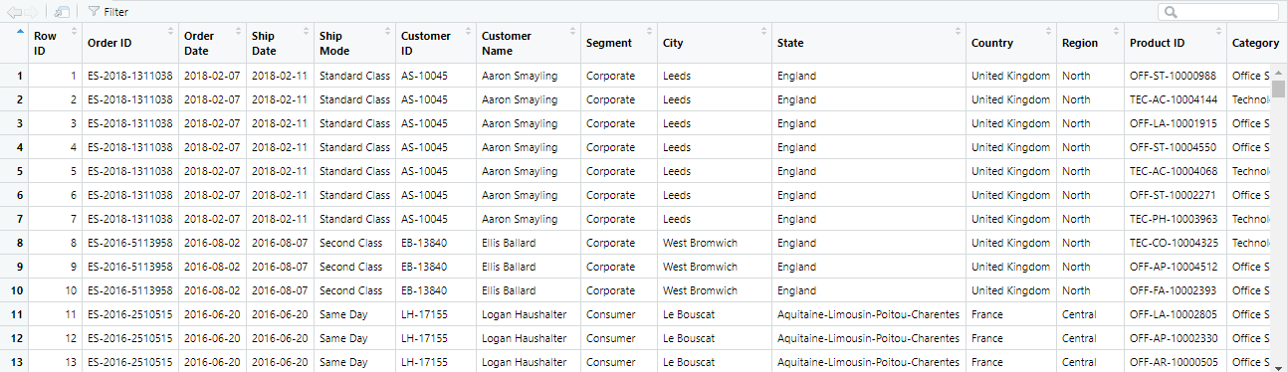
Importing the Dataset
Before importing the data into R for analysis, let’s look at how the data looks like:
Let’s have a quick look at the dataset in RStudio.

Slide 5
Objectives
The objective of this project is to analyze and identify trends and patterns in the current retail sales and identify which sector of the market is under loss and which sector is making huge profits. Every sector offers discounts on sales, but, do they collect profits as needed on the discounts they offer? Which shipment class boosts the sales of which category?

Slide 6
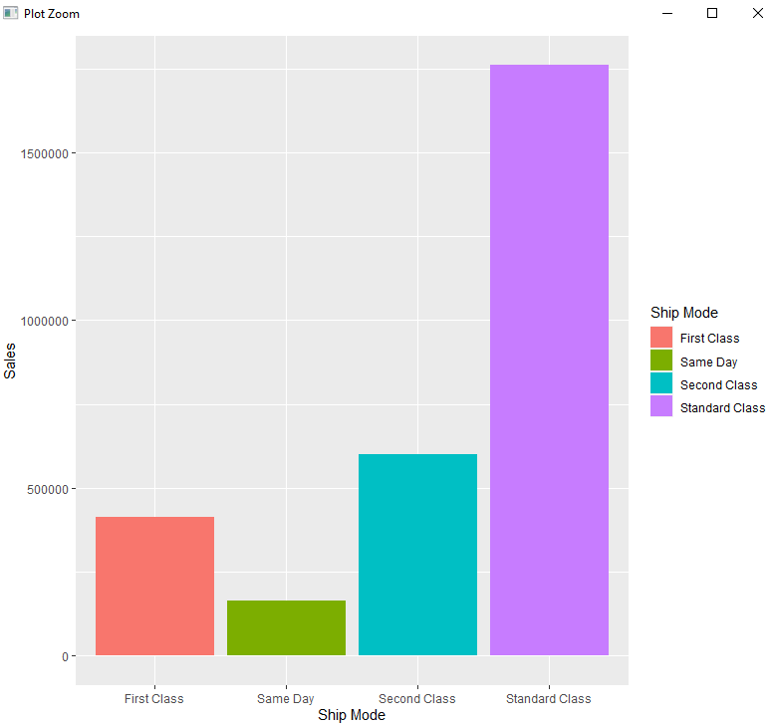
Visualizing the Data
Let’s visualize patterns in our dataset.
First we will look into Sales vs Quantity
In the mentioned graph, we see the
following a pattern that most of the sales
have been triggered by the standard
class of shipment mode.

Slide 7
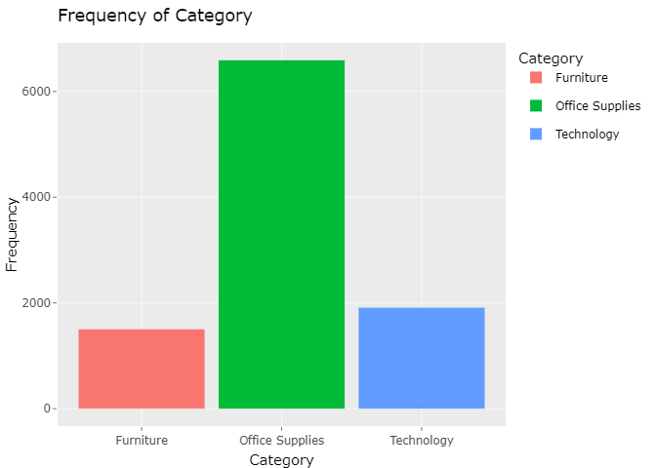
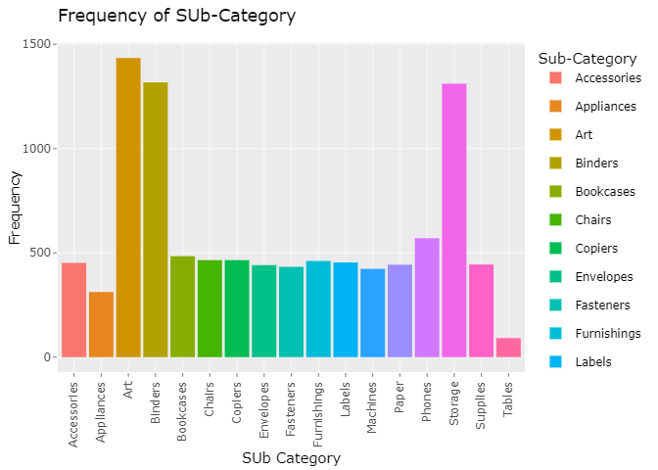
Category Counts of Superstore
Sub-Category Counts of Superstore
This graph demonstrates that the superstore offers a large range of Art, Binder, and Storage items in Sub-Category.
This bar plot shows that the superstore has more Office Supplies than Technology or Furniture.

Slide 8
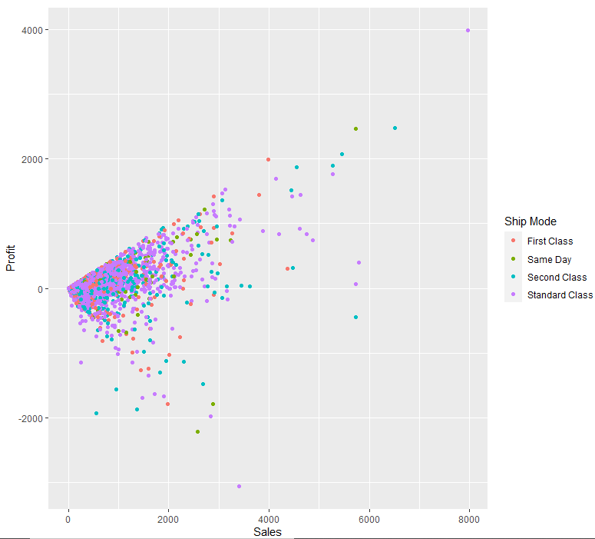
Sales Vs Profit
As we know that more profit/loss has been availed
from the standard shipment class.
But there are not higher range profits seen
this feature.
So we will look into the sales vs profit pattern.

Slide 9
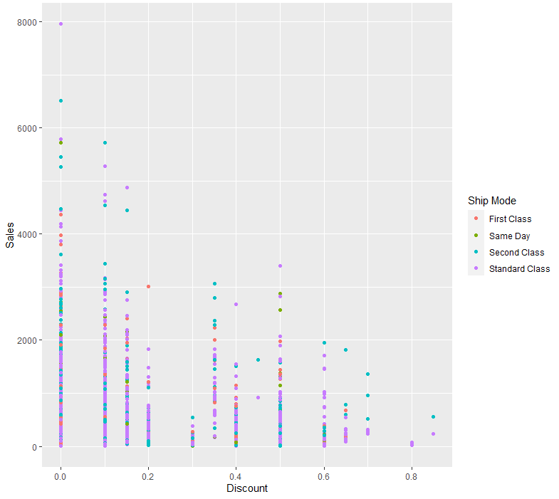
Sales Vs Discount
Let’s see how sales are affected if discounts are
offered.
It is evident from the above graph that discounts
attract more sales. But, discounts attract mostly the
Standard Class shipment. Same-day shipment
mode receive the least discount offers.

Slide 10
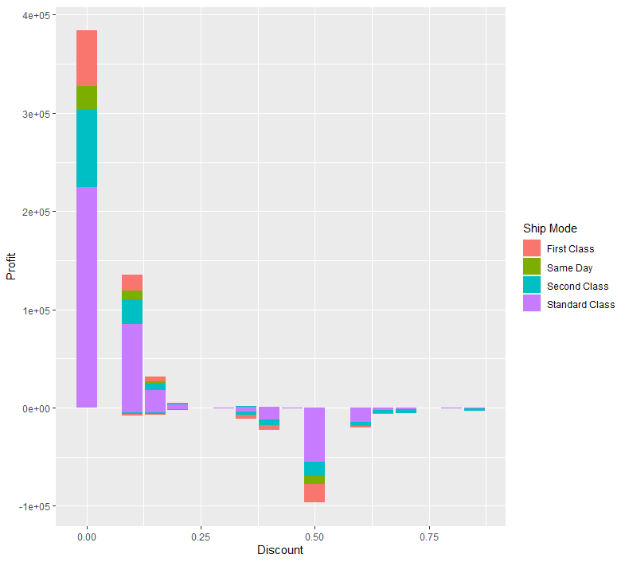
Profits Vs Discounts
Now let’s see whether profits have been triggered
if discounts have been redeemed.
So, we see clearly, that more discounts have been
offered and redeemed, the lesser profits the
segments have been achieved. Products with
No discounts show a high range of profits but as
the discount range increases, we only see more
and more loss with hardly any profit.

Slide 11
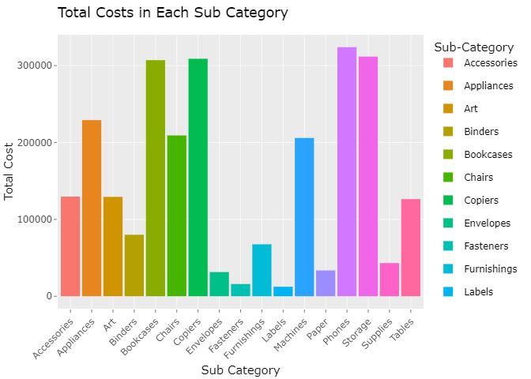
Finding the Cost
Copier, phone, storage, and bookshelf costs are higher for retailers.

Slide 12
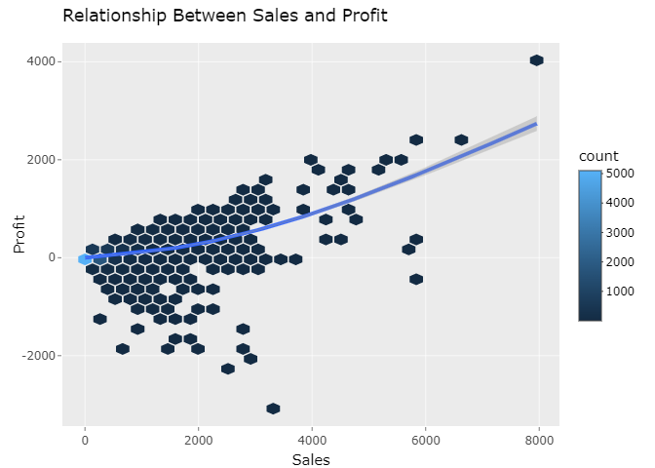
Relationship between Sales and Profit
The Profit increases as the Sales increases.

Slide 13
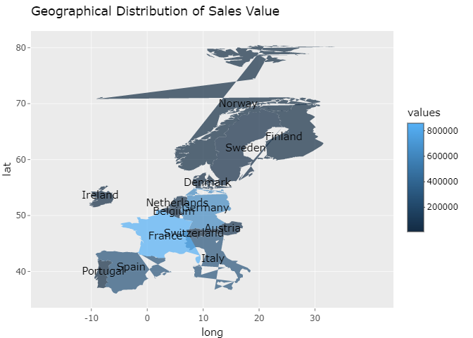
Geographical Plots of Country-wise Sales
Because the value of sales in France, the United Kingdom, and Germany is higher, we should extend our product offerings in these nations.

Slide 14
Conclusion
Same day shipment if receives more discounts can trigger sales/profits. Discounts should be based on the Sales and should not increase a particular range otherwise unnecessary discounts with low sales can witness huge losses Binders and Machines industry should be focused upon more so as to strengthen these weakened industry areas. Office Supplies and the Furniture industries do not seem to boom in the Central Region.

Slide 15
So, this is it. We chose a simple, dataset to start with and learned how to manipulate data using a few simple functions.
Thank You!

